Slide 1



Taming the Instruction Bandwidth of Quantum Computers via Hardware Managed Error Correction
MICRO-50
Swamit Tannu
Zachary Myers
Douglas Carmean
Prashant Nair
Moinuddin Qureshi
Notes:
Good morning! I am Swamit, I am a PhD student at Georgia Tech, Today I am going to talk about how computer architecture and instruction bandwidth bottleneck.
and we did this work in collaboration with Doug Carmean at Microsoft Research and Prof. Moinuddin Qureshi is my advisor.

Slide 2
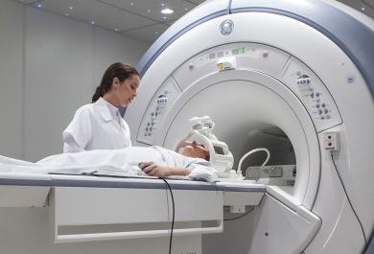
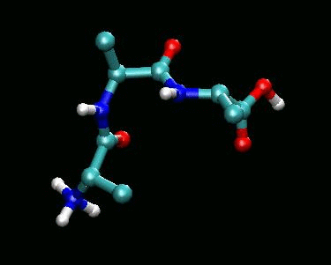
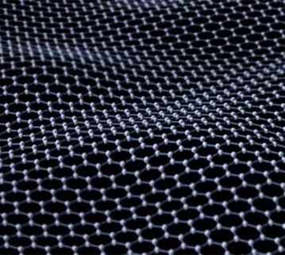
Why Quantum Computers?
Billion Years
Classical Computer
Molecule and Material Simulations
Execution Time
Quantum computers provide large speedup for problems in material science, machine learning, and medicine
Days
Quantum
Computer
Problem Size
Quantum Computers enable solutions to important problems
Notes:
Why build quantum computers? So Quantum computing promise that we can solve problems which are unsolvable with todays computers, problems like molecular simulations
So how do quantum computer get this speedup? – So quantum computers leverage the properties of quantum bits to run extremely efficient quantum algorithms

Slide 3
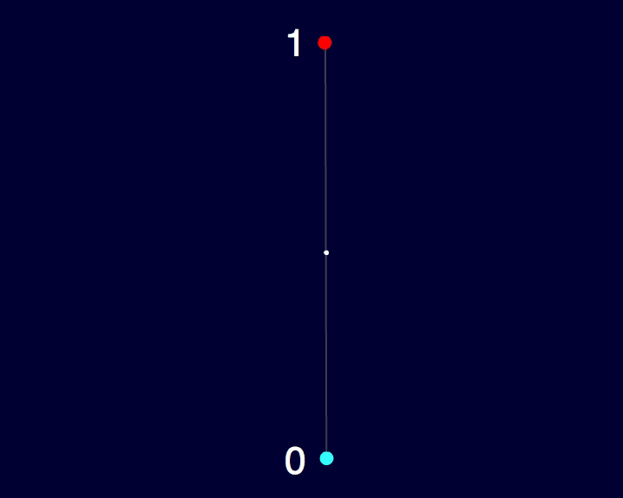
Quantum Bits: Background
State of a Classical Bit
→ 1 or 0 two points on sphere
State of a Quantum Bit
Any point on the sphere
Quantum Bit
Classical Bit
Quantum computer use quantum bits (qubits) to encode the information.
Notes:
Conventional computers- use classical bits to encode information which is one or zero
Whereas quantum computers use quantum bits, state of a quantum bit can be any possible superposition of 1 or 0. If classical bit can be represented as two point on the sphere, the state of the qubit can be represented as any point on the sphere.
Animate Sphere first and then talk about quantum bit

Slide 4
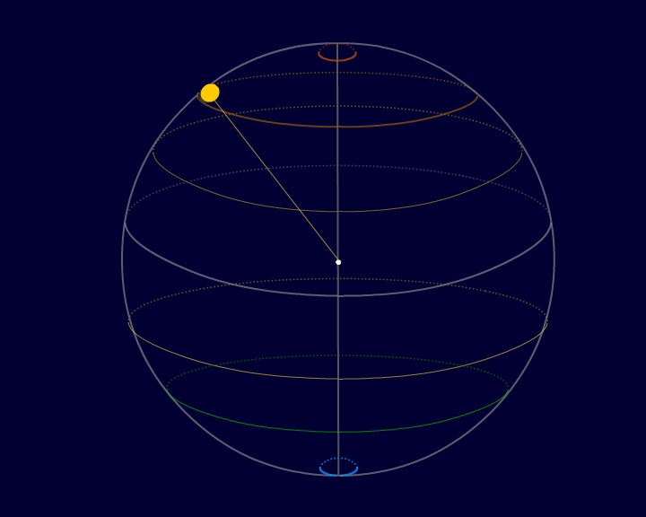
Quantum Instruction: Background
Quantum Instruction
Quantum Instructions manipulate the state of qubit
By rotating state vector in the Hilbert space
Notes:
To manipulate the state of qubit we can use quantum instructions. Which rotates the state vector from one point on the sphere to other point on the sphere.

Slide 5

Organization of Quantum Computer
Control Processor
Qubits
Quantum Computer
Control Processor -- Interface between Qubits & Programmer
Notes:
but we need something that can feed instructions to qubits to manipulate the state of the qubits, so we use control processor to feed instructions to the qubits. It act as an interface between programmer and qubits. It executes the quantum program by manipulating and reading states of the qubits.
Unfortunately qubits are fickle and extremely low temperature

Slide 6
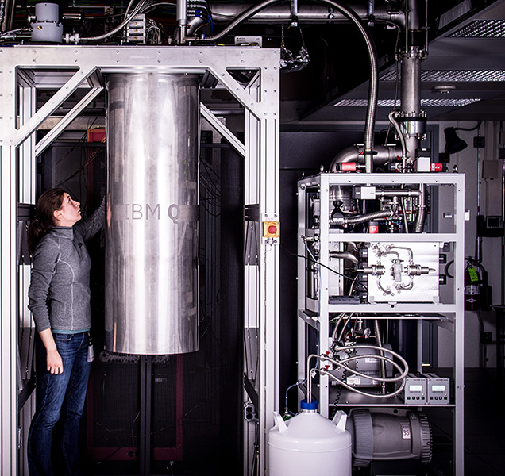
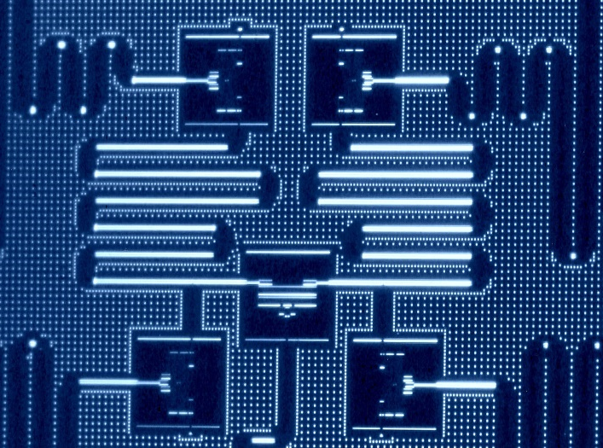
Todays Quantum Computer
Dilution Refrigerator
5 Qubit Chip (IBM)
Qubits
5 Qubit Chip (IBM)
20mK
Ref: IBM Quantum Experience
Notes:
1 min

Slide 7
Cryogenic Control Processor
Control Processor
300K
(27ºC)
Control Processor
4K
(-269º C)
Metal Wires
→ Thermal Leakage
Superconducting wires
→ Low Leakage
Qubits
20mK
20mK
Qubits
Cryogenic Control Processor is essential for scalable Quantum Computer
(Ref: Cryogenic Control Architecture for Large-Scale Quantum Computing by Hornibrook et. al)
Notes:
Today, So for a small scale quantum machines control processor is kept at room temperature which is around 300K and it is connected to the qubits via long co-ax cables. This works for 10s of qubits What if want to build 100 qubit machine? Well then the organization is not quite scalable because theres huge thermal gradient across wires, and wires that conduct electricity conduct heat which can lead to thermal leakage and increase in the temperature leading to thermal noise and errors.
To solve this issue, Designs have been proposed to keep the control processor at 4K which reduces thermal gradient and can use superconducting wires which have extremely low heat leakage.
What are the challenges in building control processor and how do we architect control processor ?
More wires → lead to more leakage
Thermal Heirachy

Slide 8
Scalable Organization

Slide 9
Outline
Background
Problem → Instruction Bandwidth Bloat due to Error Correction
Design → HW managed error correction
Challenges
Evaluation & Conclusion
Notes:
Don’t talk about Design and next things

Slide 10
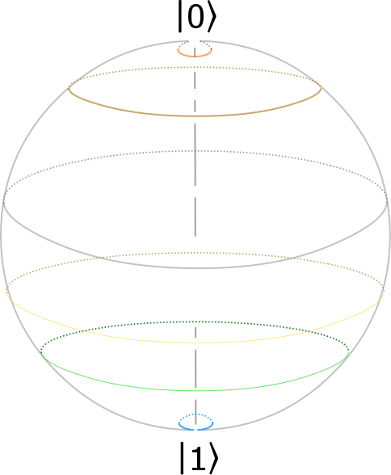
Quantum bits are fickle
Even at 20mK, qubits can lose state
1
0
Classical Bit
Quantum Bit
Need Error Correction to protect Quantum bits
Notes:
Quantum bits are fickle, and even at 20 mk they can lose the state by interacting with their environment. So classical bits are fundamentally robust because they are protected by quantization whereas qubits don’t have that even a small perturbation can move state of qubit from one point on the sphere to other
So we need forward error correction techniques to protect the quantum information. But we cant use conventional as is because we can not measure a qubit because that will destroy its state and we can not copy a state of the qubit. So That means we need to implement error correction without copying or measuring the qubit.

Slide 11

Quantum Error Correction
Copying qubits is not allowed
Measurement destroys the qubit state
Quantum Error Correction can protect qubits
Control Processor
No Copy
Qubits
Continuous Quantum Error is essential to protect the state
Notes:
Quantum bits are fickle, and even at 20 mk they can lose the state by interacting with their environment. So classical bits are fundamentally robust because they are protected by quantization whereas qubits don’t have that even a small perturbation can move state of qubit from one point on the sphere to other
So we need forward error correction techniques to protect the quantum information. But we cant use conventional as is because we can not measure a qubit because that will destroy its state and we can not copy a state of the qubit. So That means we need to implement error correction without copying or measuring the qubit.

Slide 12
Quantum Error Correction
Quantum Error Correction (QECC) protect data qubits by entangling data qubits with ancilla qubits
Errors are detected by measuring ancilla qubits (syndrome)
Measurement destroys the entangled state (syndrome)
Data Qubits
Ancilla
Qubits
Syndrome Generator
Error
Syndrome Measurement
QECC is applied on all qubits continuously to preserve state
Notes:
Fortunately theorists have designed the quantum error correction codes which can protect qubits without disturbing the state of qubit. So to protect data qubits quantum error correction protocol use these extra quantum bits called ancilla qubits. QECC entangles the data qubits with ancilla qubits and now we can detect the changes in state of data qubits by measuring the ancilla qubits. But measuring the ancilla qubits destroys this entangled state and we need rectangle the data with ancilla to keep the data protected.. An this process is repeated continuously on all qubits.
This recipe of generating and measuring syndrome can not be hardcoded –
Stict to script – avoid the lose words

Slide 13
Programmable Quantum Error Correction
Different QECC Designed
New error correction codes → QECC needs to be programmable
Software managed QECC → Compiler inserts QECC instructions in regular instruction stream
Different Error Correction Designs
Surface
Code
Twist
Code
Cost
Planer
Codes
Triangle
Code
Concatenation
Code
Error Rate
Notes:
QECC design is evolving field and there are lot of tradeoffs in QECC design that depends on the technology error rate.
We want programable QECC
So SW QECC
Leads to large errors

Slide 14
Baseline Architecture
Uncorrectable Errors !!
Control Processor
Qubits
Notes:
Make baseline clear by animating the baseline– master controller sends both QECC and regular instructions
Thi

Slide 15
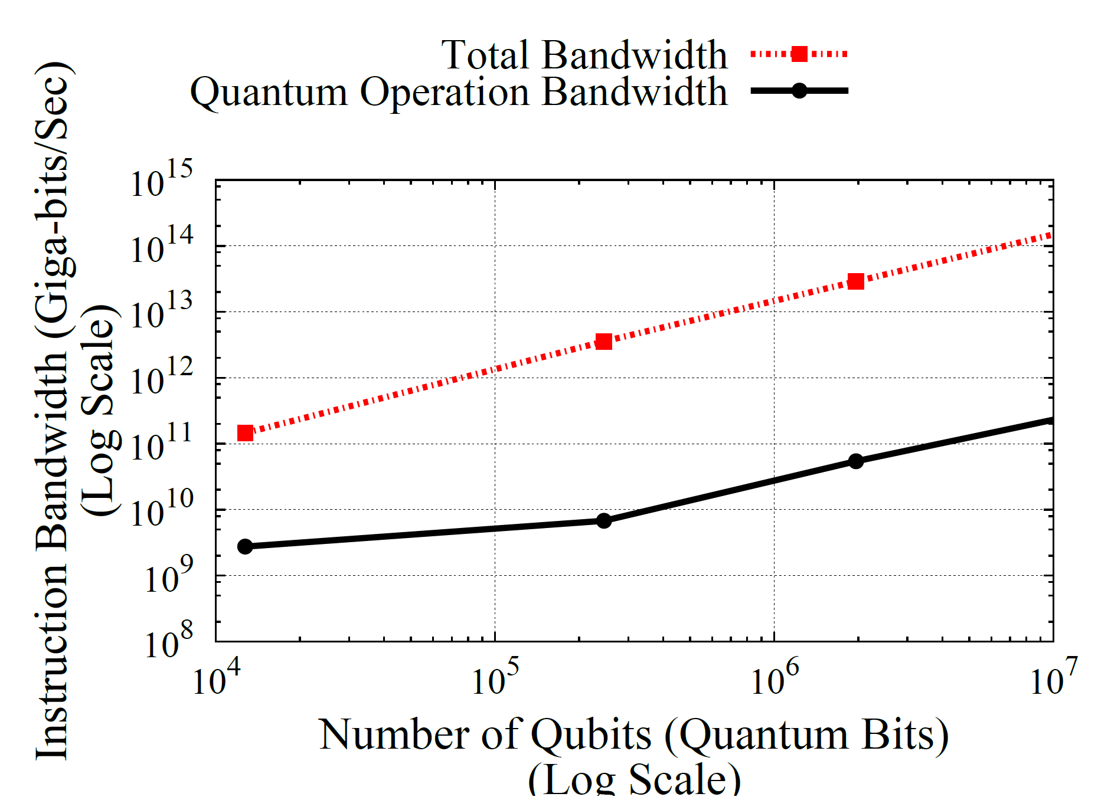

Problem: Instruction Bandwidth Bottleneck
Shor’s Algorithm
Can’t use i-cache -- delay in delivery of QECC instructions results in error
SW-QECC + no i-cache→ instruction bandwidth must scale linearly with number of qubits
Total Bandwidth
Non-QECC Bandwidth
1024 bit
QECC Bandwidth Bloat – 10,000X
Instruction Bandwidth (B/s)
Can’t use
i-cache
256 bit
128 bit
Number of Qubits
Instruction Bandwidth bottleneck ➔ 99.99% of instructions are QECC
Notes:
Cant use icache danger sign for storing the ecc if you get a miss then you will go to memory get the instruction mean time you have errors which you can correct
Non determinism is bad
We need instructions for all the qubits
You will need as many concurrent streams as qubits

Slide 16
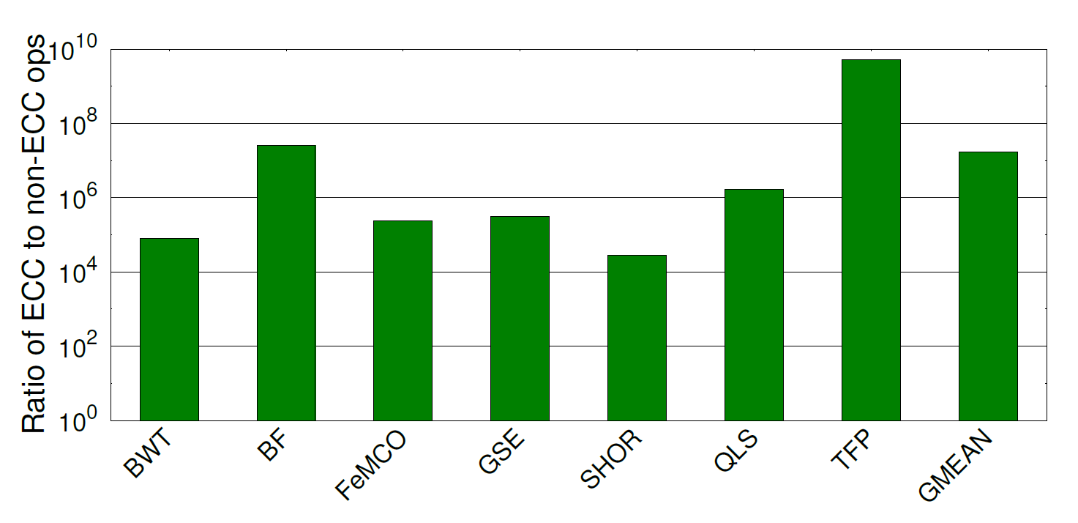
QECC Instruction Bandwidth Bloat
Realistic Quantum workloads require substantially large number of qubits
Large number of qubits → must support large instruction bandwidth
QECC instruction bloat is dominant in all large scale quantum workloads
Notes:
This problem is across all workloads, and we analysed representative quantum workloads
This Graph shows blah blah bars represented,

Slide 17


Programmability
BW Efficiency
Software-Managed QECC
Hardcoded
QECC
Goal: To enable programmable Quantum Error Correction without bandwidth bloat

Slide 18
Insight
QECC can be executed independently without any global synchronization
QECC is simple enough to manage in hardware using programmable microcode
Notes:
Jump in the understanding

Slide 19
QuEST Architecture
Master Controller
MCE continuously issues QECC µops from local µcode
Master controller issues regular instructions. MCE decodes it to µops
Control Processor
µ-Code
Engine
µ-Code
Engine
µ-Code
Engine
µ-Code
Engine
Qubits
QuEST alleviates instruction bandwidth by issuing QECC ops locally
Notes:
Make baseline clear by animating the baseline– master controller sends both QECC and regular instructions
Thi

Slide 20
MCE Microarchitecture
QuEST alleviates instruction bandwidth by issuing QECC ops locally
Notes:
1.30 min

Slide 21
Microcode Design
Logical Microcode → supplies logical µops
QECC Microcode → supplies QECC µops to all qubits
Mask Bits → selects between QECC µop and Logical µops
Quantum Execution Unit
Dedicated QECC microcode continuously run QECC
Notes:
Quantum microcode needs to be explained in much better fashion – use consistent animation one qubit to n qubit jump

Slide 22
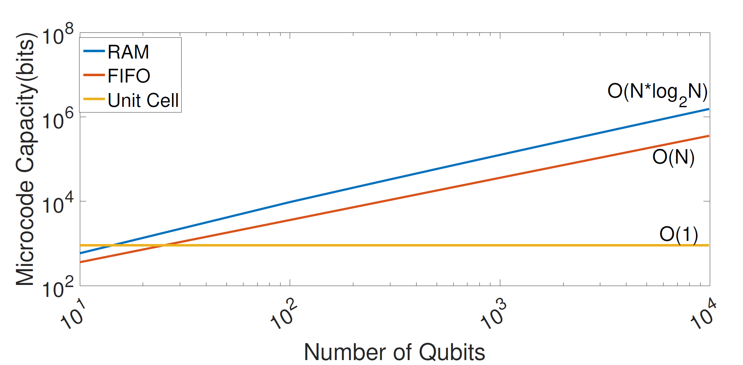
Microcode Memory Capacity Requirements
µ-Code
Log(N) bits
C bits
QECC µops
Qubits
Microcode memory capacity requirement increase linearly with no. of qubits
Notes:
NO need of opcode

Slide 23
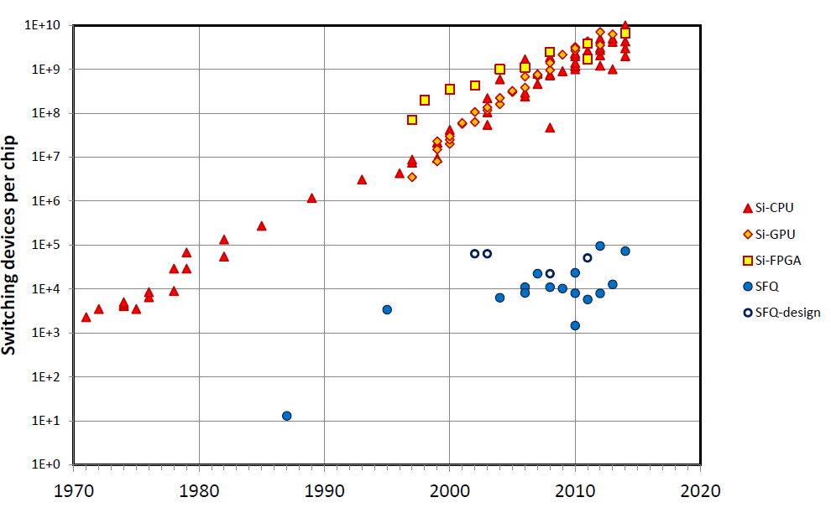
Limited Memory Capacity at 4 Kelvin
1E+10
1E+9
1E+8
1E+7
1E+6
1E+5
1E+4
1E+3
1E+2
1E+1
1E+0
CMOS
JJ-Memory Capacity
JJ-logic
Data
Energy
10⁵
Frequency
Device Density
4 Kb/cm²
JJ – Works at 4K
Ref: Beyond CMOS Superconducting Digital Circuits by MIT Lincoln Labs
Capacity of JJ-based memory is limited
Notes:
30 sec

Slide 24
Memory Capacity Limits Number of Qubits
Capacity of state of the art JJ based Memory
4Kb µcode memory can only support about 35 qubits
Notes:
2 mins

Slide 25
Insight- Repetition in QECC Instructions
Unit Cell
Unit Cell
A
B
C
D
QECC
µops
A
B
C
D
A
B
C
D
A
B
C
D
Qubit1
Qubit12
QECC have spatially repeating instruction blocks -- Unit Cell
Unit-Cell µops can generate QECC µops for all the qubits
QECC instruction patterns are leveraged to minimize µcode capacity
Notes:
Unit cell need clearification
Why what is it ?
Animation for unit cell

Slide 26
Insight- Repetition in QECC Instructions
Unit Cell
QECC
µops
A
B
C
D
A
B
C
D
A
B
C
D
Qubit1
Qubit12
QECC have spatially repeating instruction blocks -- Unit Cell
Unit-Cell µops can generate QECC µops for all the qubits
QECC instruction patterns are leveraged to minimize µcode capacity
Notes:
Unit cell need clearification
Why what is it ?
Animation for unit cell

Slide 27
Unit-Cell Enables Constant Storage
Capacity of state of the art JJ based Memory
O(1)
QECC instruction patterns are leveraged to minimize µcode capacity
Notes:
2 mins

Slide 28
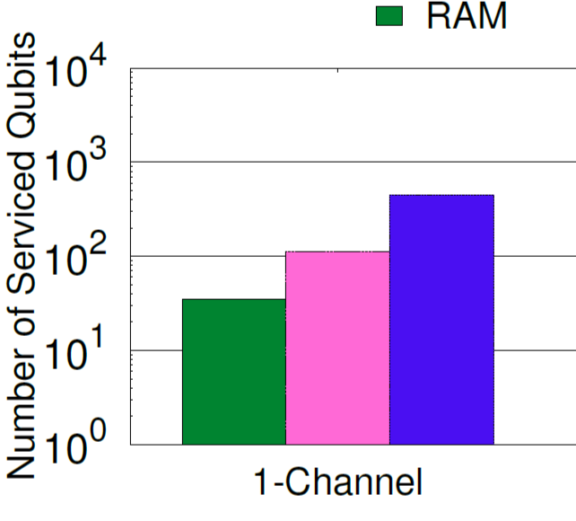
Number of Qubits Serviced
90x
UNIT
CELL
UNIT
CELL
FIFO
RAM
For 4Kb Memory Budget
Microcode can service up to 2000 qubits with 4Kb of microcode
Notes:
Redudant

Slide 29
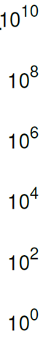
Evaluations
10⁷x
Reduction in Global
Instruction BW Demand
QuEST reduces global bandwidth demand by seven orders of magnitude
Notes:
Why we get this benefit ?
Most of the instructions stem from QECC we handle QECC in microcode and that reduces the instruction bandwidth demand by several orders of magnitude. This graph shows Reduction in Global
Bandwidth demand on the y axis for quantum workloads including Shors algorithm.
On average Quest reduces instruction bandwidth demand by seven order of magnitude

Slide 30
Conclusion
Programmability
BW Efficiency
Software-Managed QECC
Hardcoded
QECC
QuEST (µcode)

Slide 31
Conclusion
Software managed QECC leads to impractical instruction bandwidth demands
We propose to manage QECC using programable microcode for taming the instruction bandwidth demand
We leverage the locality in QECC to enable scalable microcodes
Need of thinking dynamic-static, hardware-software abstractions for quantum control processor
Notes:
Use would be when making statements about the

Slide 32
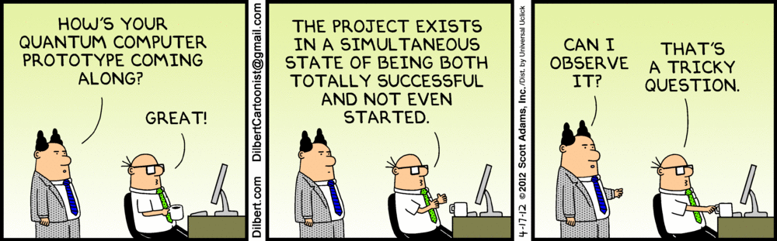
Questions?
Notes:
Want to know more about quantum …
Thank you and I will be happy to take questions

Slide 33
Backup slides

Slide 34
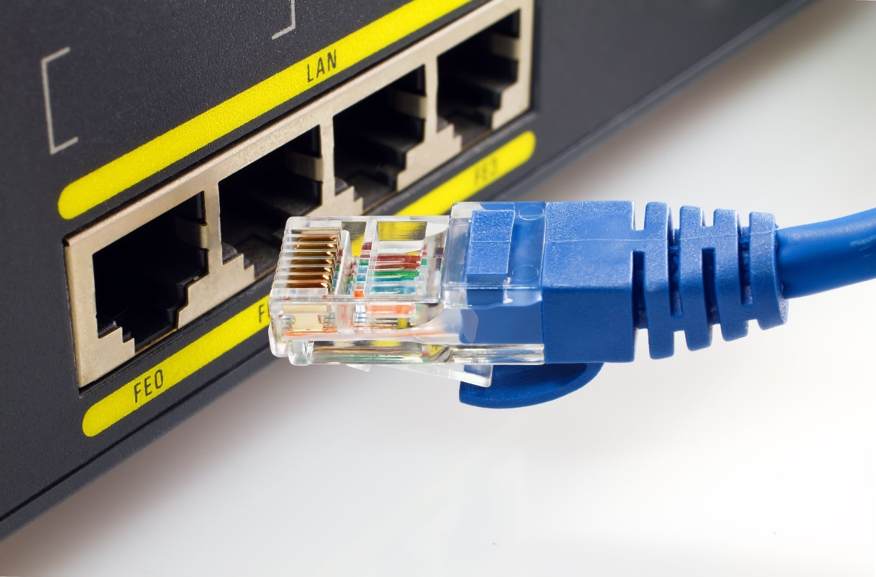
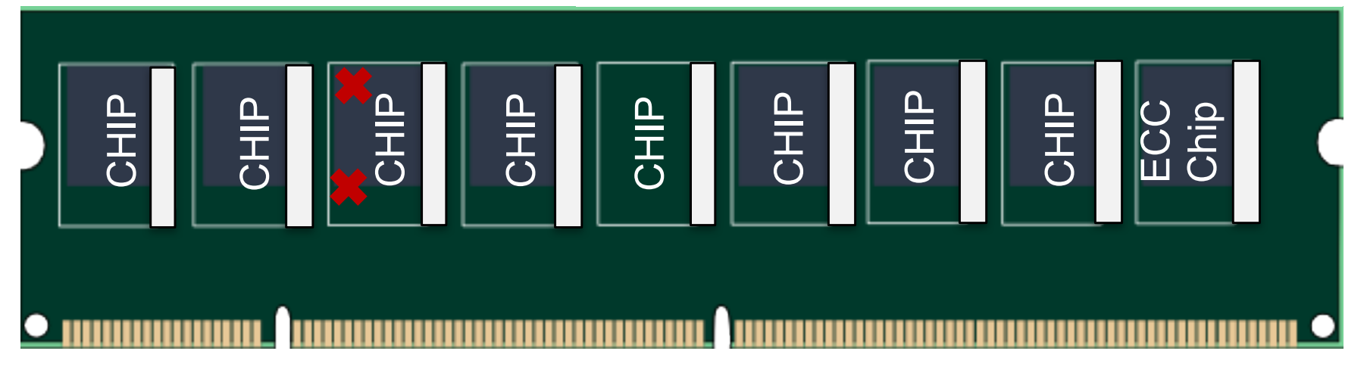

Slide 35
Quantum Execution Unit
I
00
00
00
10
00
Notes:
1.30 min

Slide 36
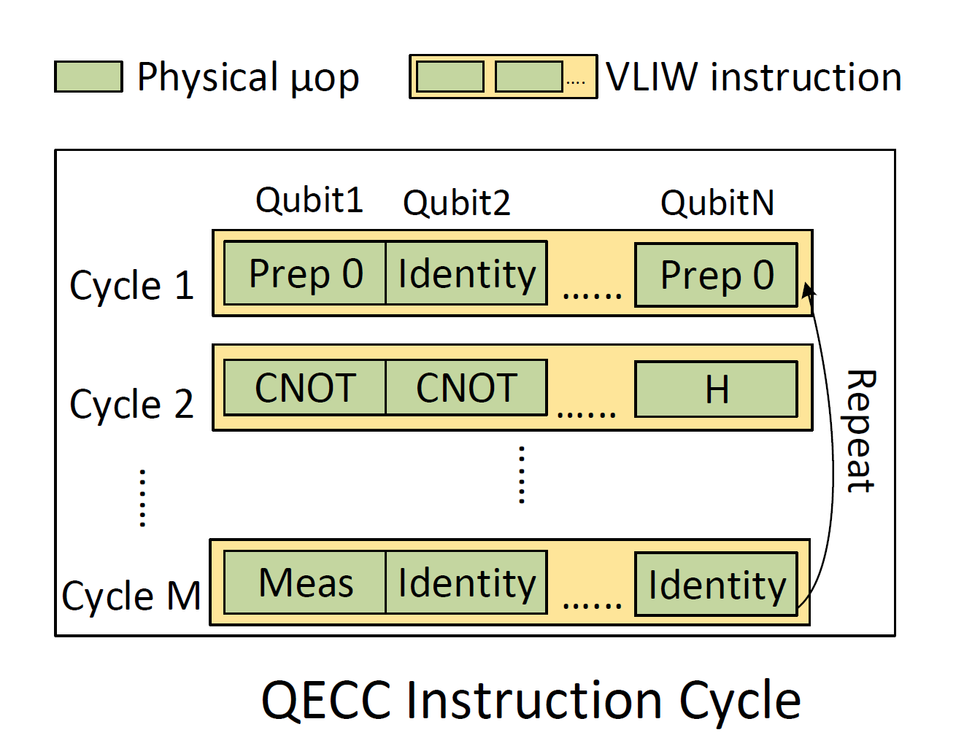
QECC Instruction Scheduling
QECC µops are scheduled on data+ ancilla qubits
VLIW like instructions
‘M’ instructions in a QECC cycle
Instructions are repeated
00 00 00 10
QECC µops are packed in a VLIW like instructions
Notes:
30 sec

Slide 37
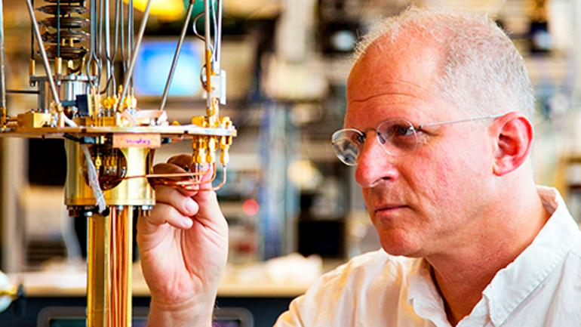
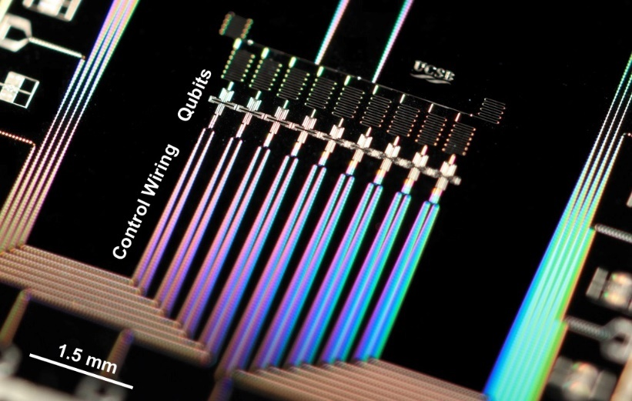
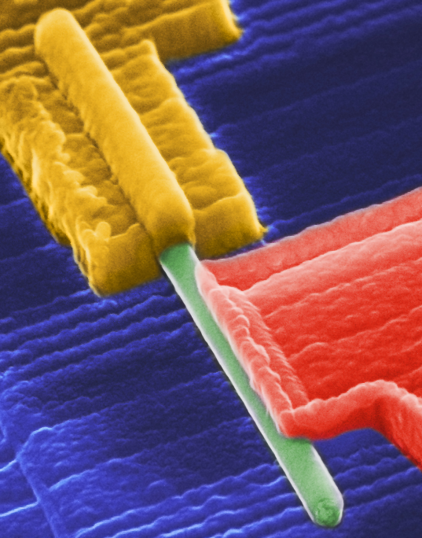
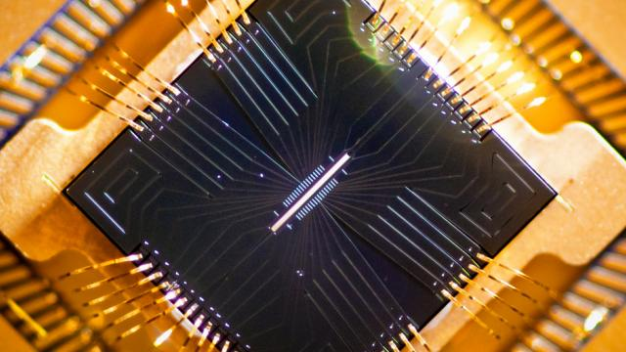
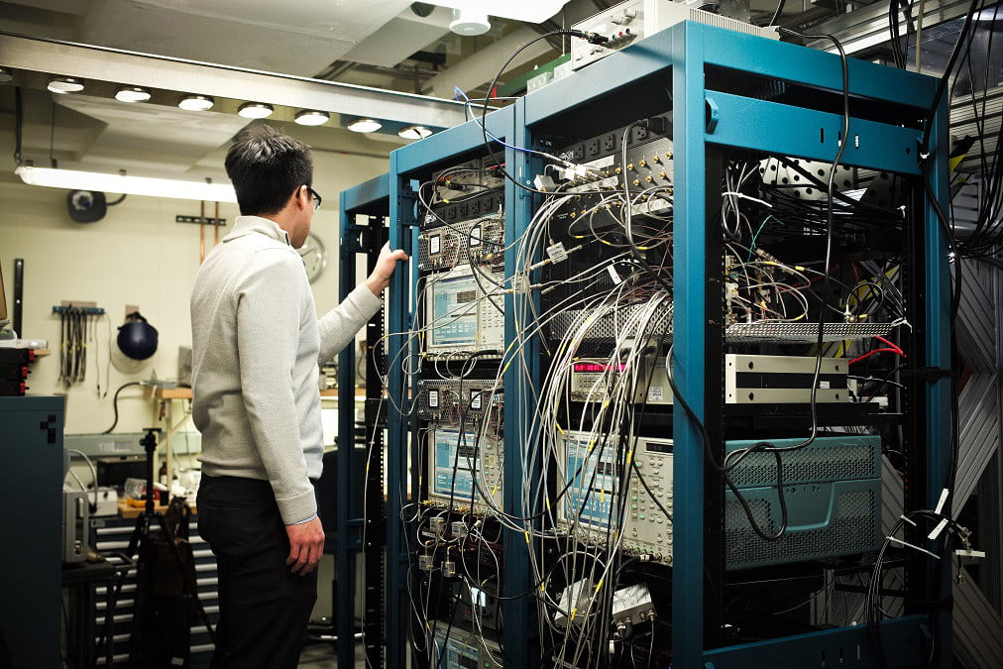
Quantum Computing: Engineering Challenges
Quantum Systems and Architecture Challenges
Quantum Algorithms
Q-Programming Language
Quantum Compilers
Quantum Architecture
IBM
Google
Microsoft
Quantum-Classical Interface
Quantum Devices
Systems and Engineering challenges are critical for scalable quantum computers
Notes:
Lot of challenges in system and architecture and these challenges are fundamentally different than regular computers. How to we understand something complex ? We build abstractions.. So here is one such abstraction to understand the quantum computer – Control processor

